Slide 1
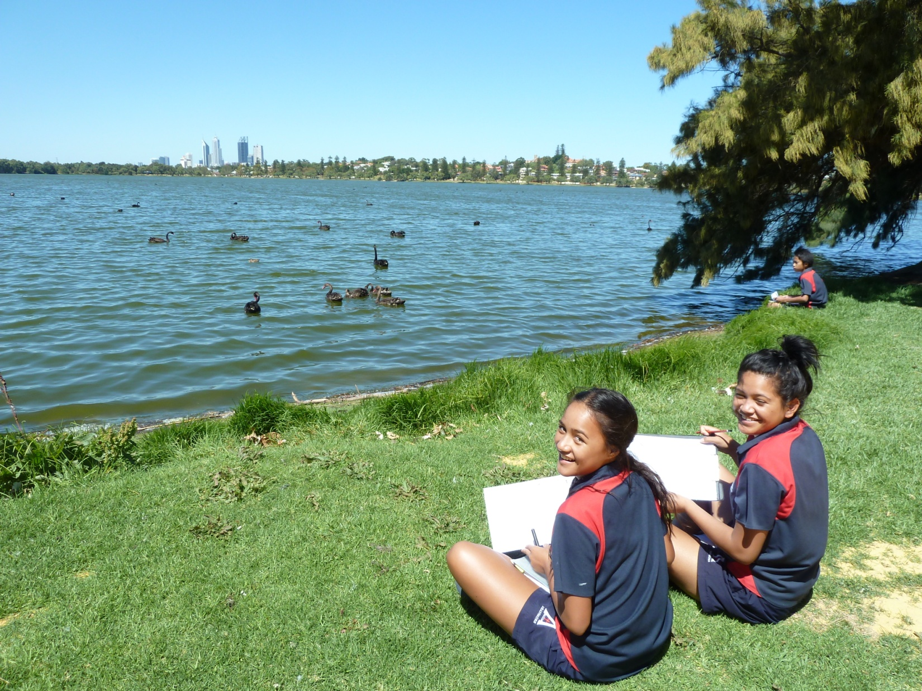
Virtual Fieldtrip to Lake Monger, Western Australia
Core units: Exemplar – Year 10
Illustration 2: Environmental change

Slide 2
Aboriginal History
Before the British settlers came, Noongar Aborigines of the Wadjuk clan had been using the lake as a camping and hunting site. The lake was their source of food since wildfowl, black swans, turtles, frogs, gilgies, mudfish and bulrushes were plentiful
Associated with the lake is also the Waugal myth, part of Noongar Aboriginal mythology. The myth describes the track of Waugal serpent, who in his journey towards the sea, deviated from his route and emerged from the ground giving rise to Lake Monger. The lake was called Galup (Kalup) by the Wadjuk people who used the lake regularly
By the late 1800s the Aboriginal people had begun to move away as there was an increase in the use of the lake by the early settlers. In 1831 it was given the name of Monger's Lake after the early settler and pioneer, John Henry Monger. This was again renamed Lake Monger in 1932 and has retained its name to this day

Slide 3
Current Land Use and Activities
Today, Lake Monger is best known for its recreational value. A 3.5 km trail has been built around the lake and it is common to see people exercising, walking their dogs or just enjoying the view from one of the park benches
Activity
Study the photograph on the first slide. Describe the lake’s aesthetic value
Study the map on the following slide. Use the key to describe as many activities and land uses as you can around the lake

Slide 4
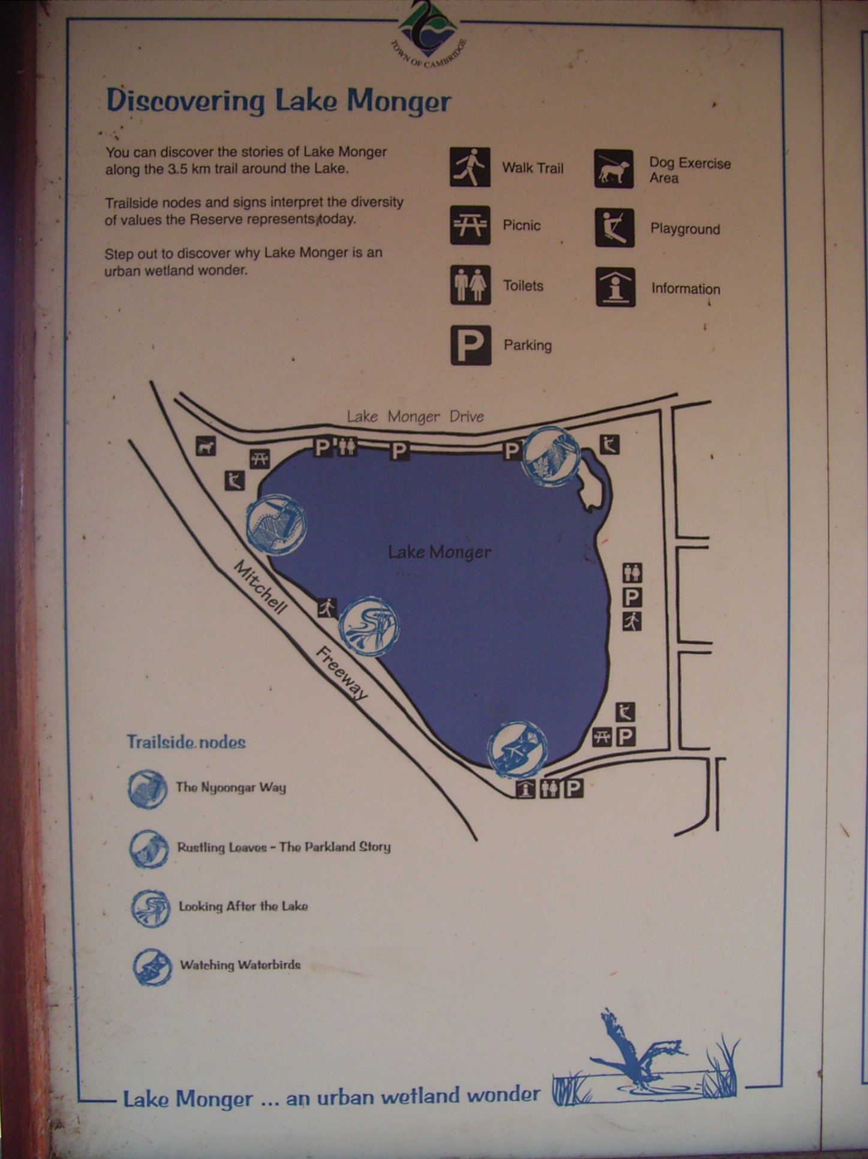
Source: Image created and supplied by Tamara Boyer

Slide 5
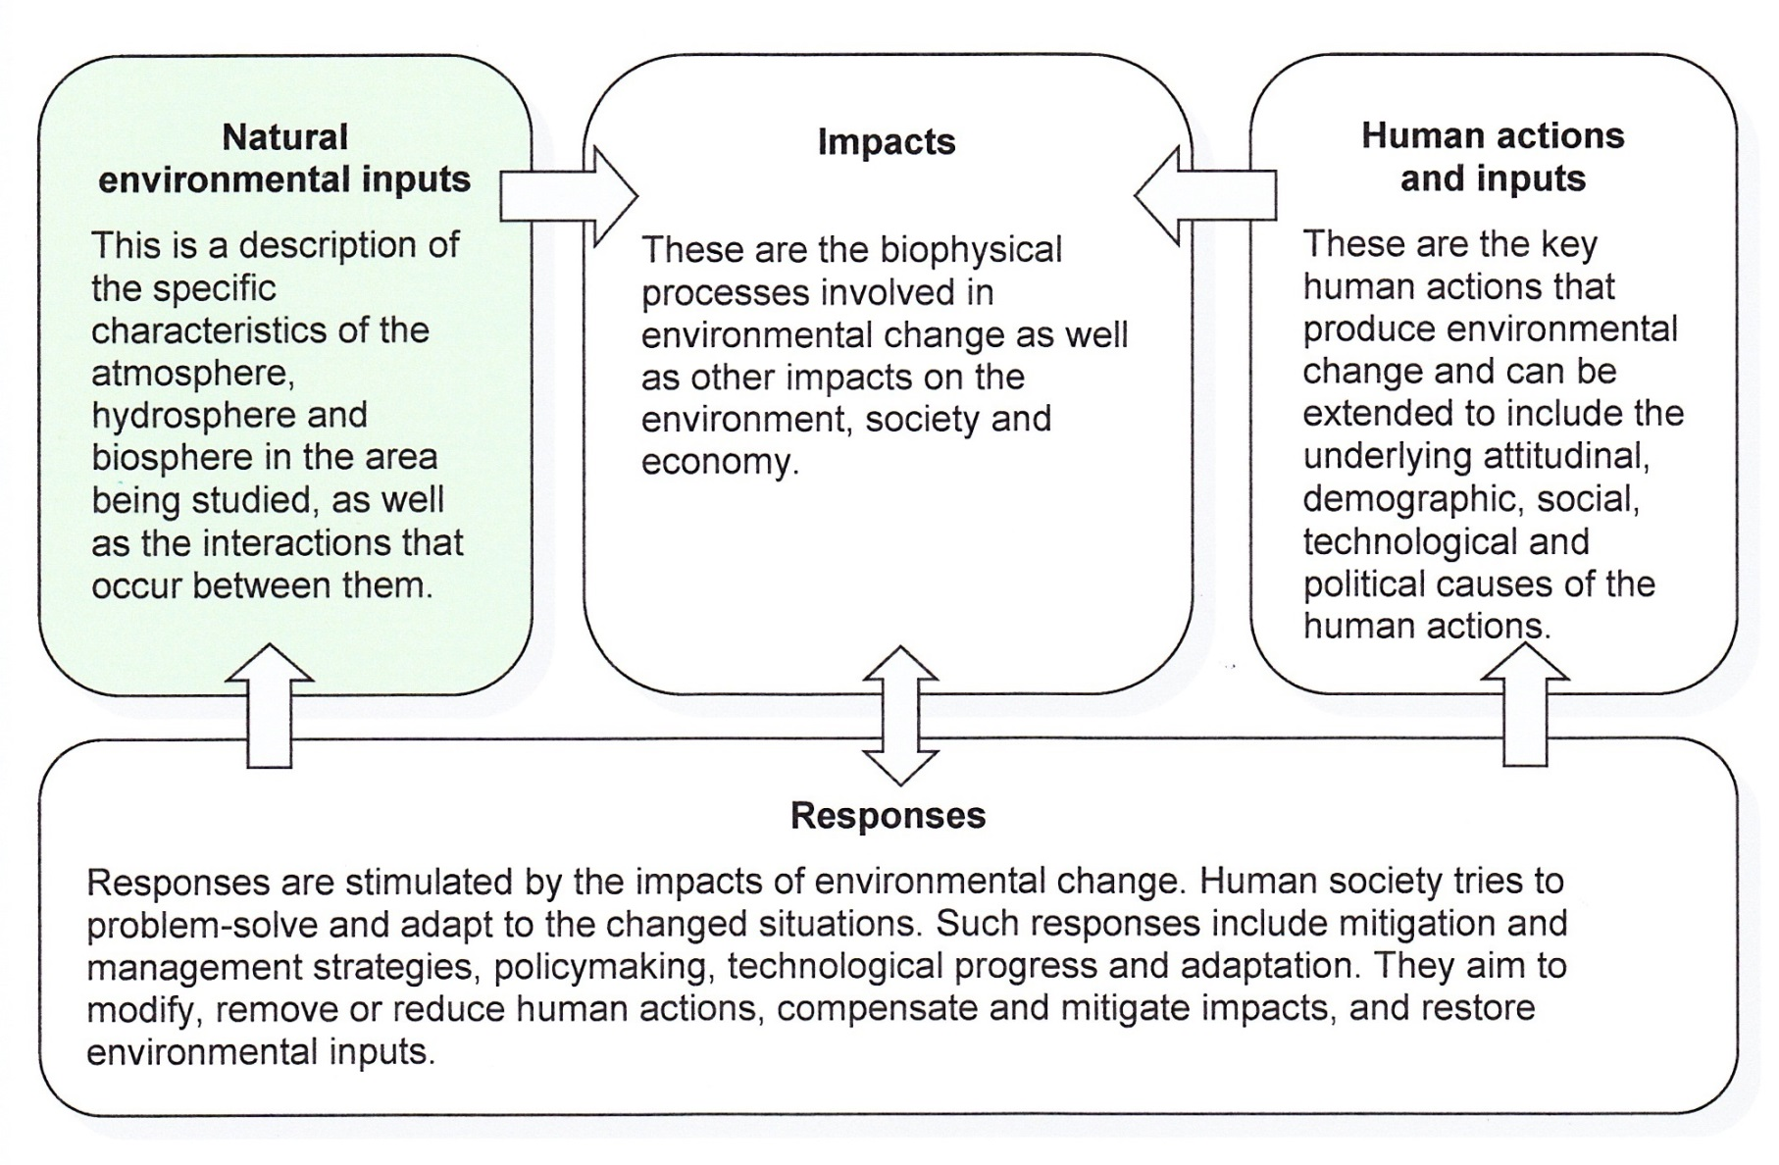
Natural Environmental Inputs

Slide 6
Lithosphere and hydrosphere
Lake Monger is located on the Swan Coastal Plain approximately 5 km north of Perth’s CBD
It is a relatively shallow fresh-water lake approximately 70 ha in area with some fringing wetland vegetation and 110 ha of public parkland
The soils lying under the lake are peaty and mainly made up of saturated organic material which makes them highly impermeable
The lake is fed by underground springs, groundwater and by 23 stormwater drains which empty into it

Slide 7
Atmosphere (climate)
Lake Monger is characterised by a mediterranean climate with relatively hot, dry summers and cool to cold, wet winters

Slide 8
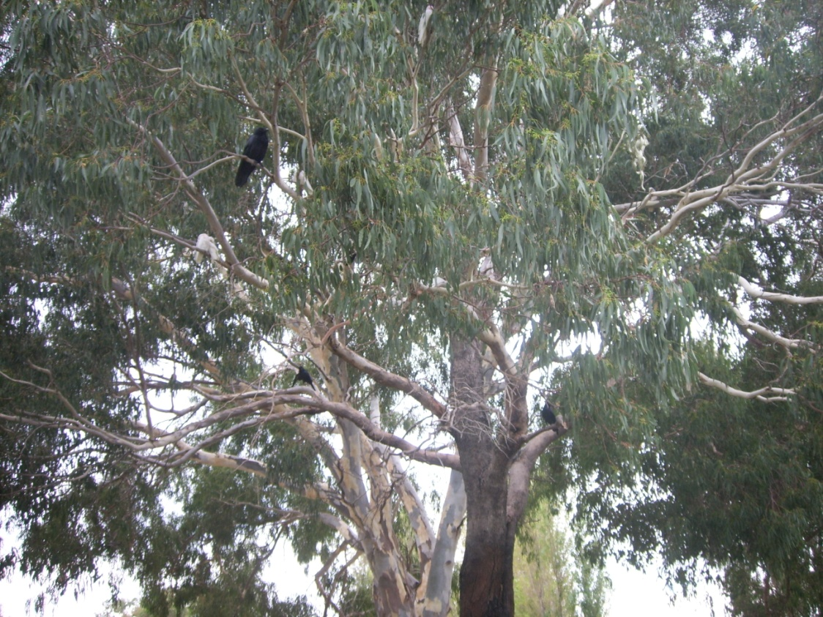
Biosphere (vegetation)
Most of the original vegetation surrounding the lake consisted of rushes, swamp paperbark, banksia, grass trees, wattle and the tea-tree. However, most of this was removed prior to the 1930s to create open waters and to plant lawns
Today, the reserve consists of open spaces with very little natural vegetation, although some of the original tree species have been replanted

Slide 9
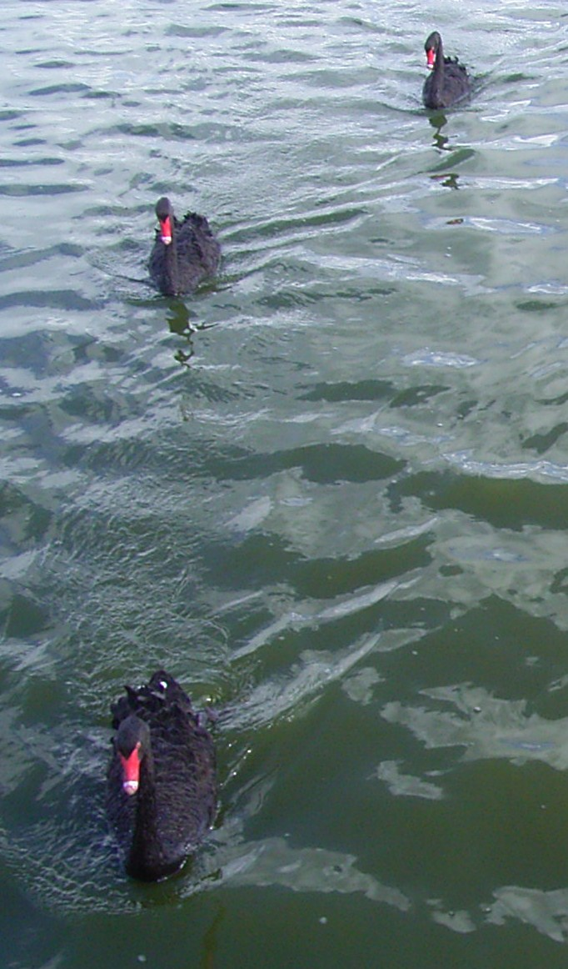
Biosphere (fauna)
Lake Monger provides a habitat for a large variety of waterbirds, the most iconic being the black swan
Other species include the glossy ibis, great crested grebe, and migratory species such as pelicans

Slide 10
Biosphere (fauna)
The lake also supports the long-neck tortoise, large skink, two species of frogs and a small variety of macroinvertebrates, which are an essential component of the food webs of the Swan Coastal Plain
Only some species of annelids and molluscs have been found in the top layer sediment of the lake because sensitive species have declined as a result of poor water quality. Larva midges still survive there because they can tolerate low oxygen conditions
Fish common to the lake are mostly ‘introduced’, and include the goldfish, carp, mosquito fish and the English perch

Slide 11
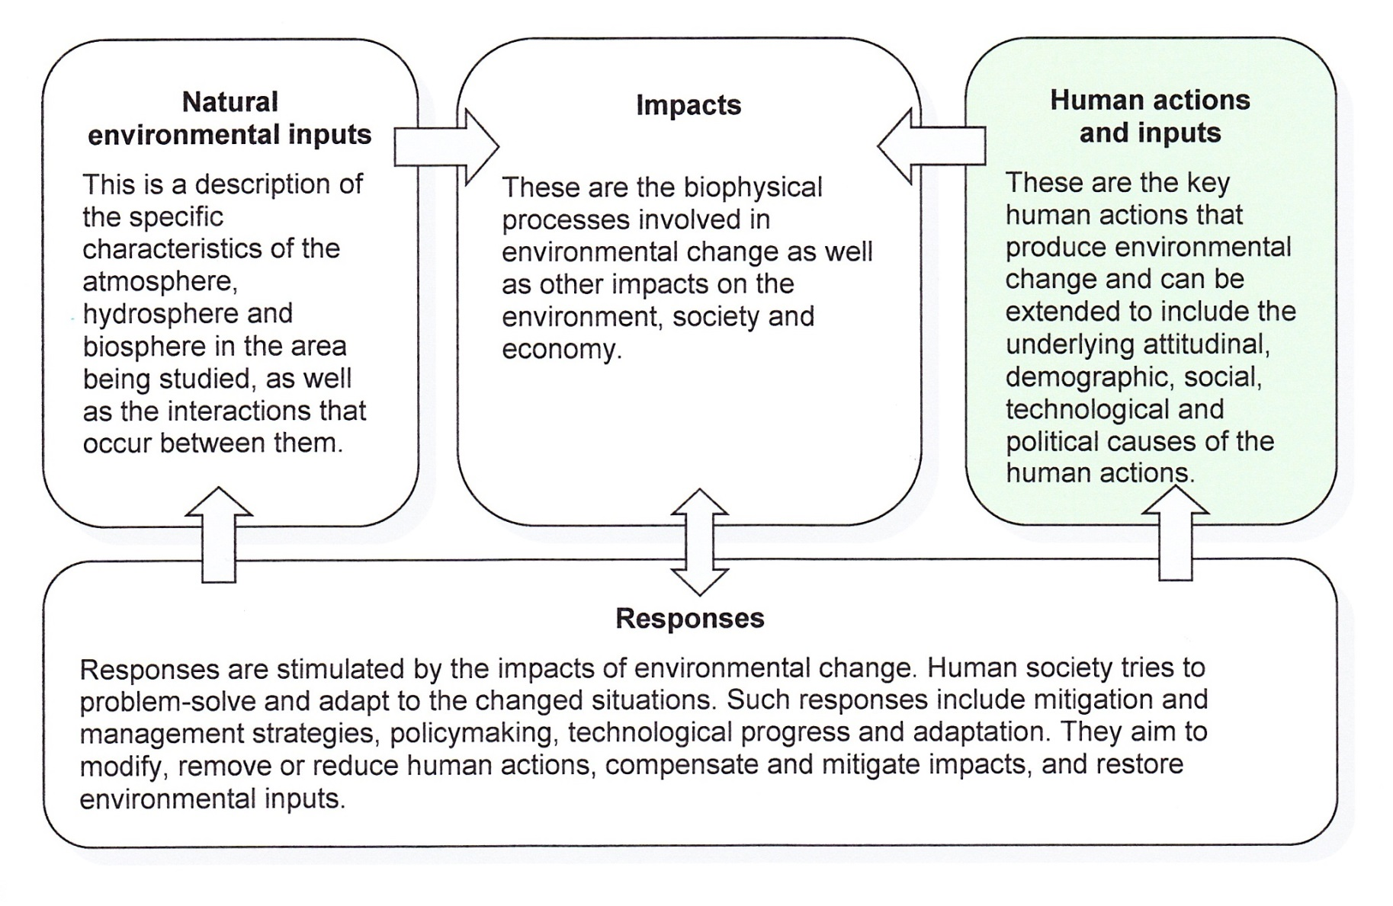
Human Actions and Inputs

Slide 12
Human actions that produce environmental change
Rapid urbanisation is the main cause of environmental change at Lake Monger
Most of the natural wetland vegetation was removed prior to the 1930s to create open waters and parkland for recreation. Exotic tree species replaced natives

Slide 13
Human actions that produce environmental change
Between 1905 and 1963 the lake was also used for the dumping of domestic as well as industrial rubbish and wastes
An Act was passed in parliament to make it law that the rubbish was stored within the shallow waters and sealed with soil within 24 hours. A rubbish- retaining wall was built for this purpose in 1932
This practice lasted until bad odours, excess of flies and mosquitoes, and fear of diseases caused residents to file a complaint against the Act

Slide 14
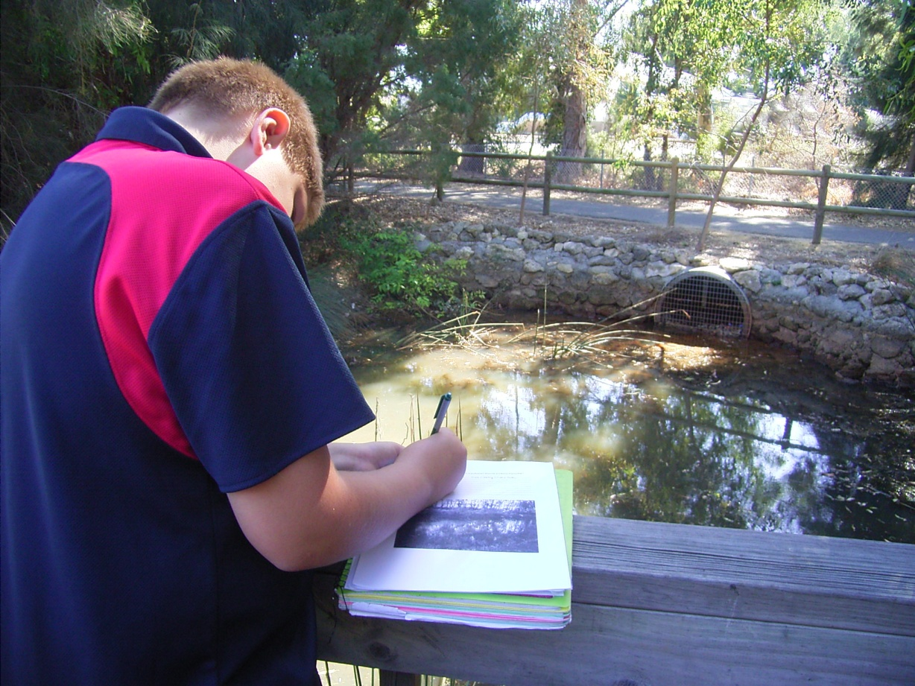
Human actions that produce environmental change
For many years Lake Monger has been used as a sink for stormwater run-off
Twenty-three stormwater drains from surrounding suburbs’ roads and the freeway empty into the lake

Slide 15
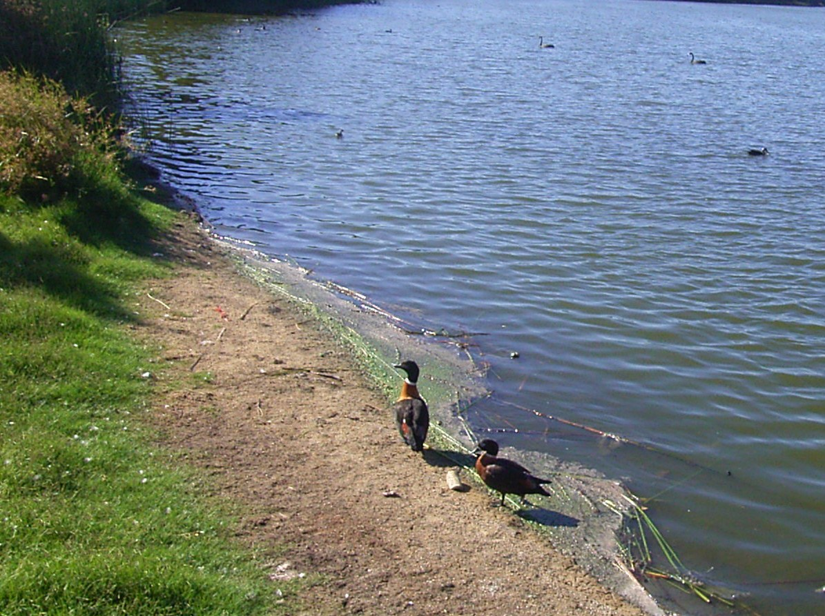
Human actions that produce environmental change
Visitors to the lake like to feed the waterbirds.
However, many people don’t realise that this can harm their digestive systems and may also make them dependent on people rather than the environment

Slide 16
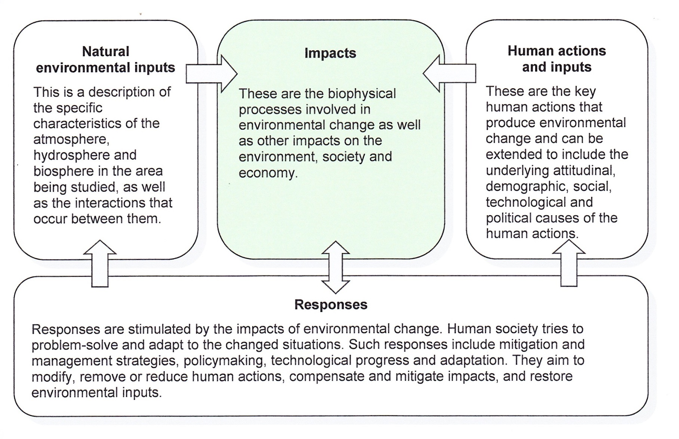
Impacts

Slide 17
Impact 1: Eutrophication
Eutrophication is the term used to describe algal blooms which develop as a result of high levels of nutrients entering waterways
These nutrients stimulate excessive plant growth (algae)
Activity
Study the photograph on the following slide which shows the point of entry of the first drain located in the north-eastern corner of the lake

Slide 18
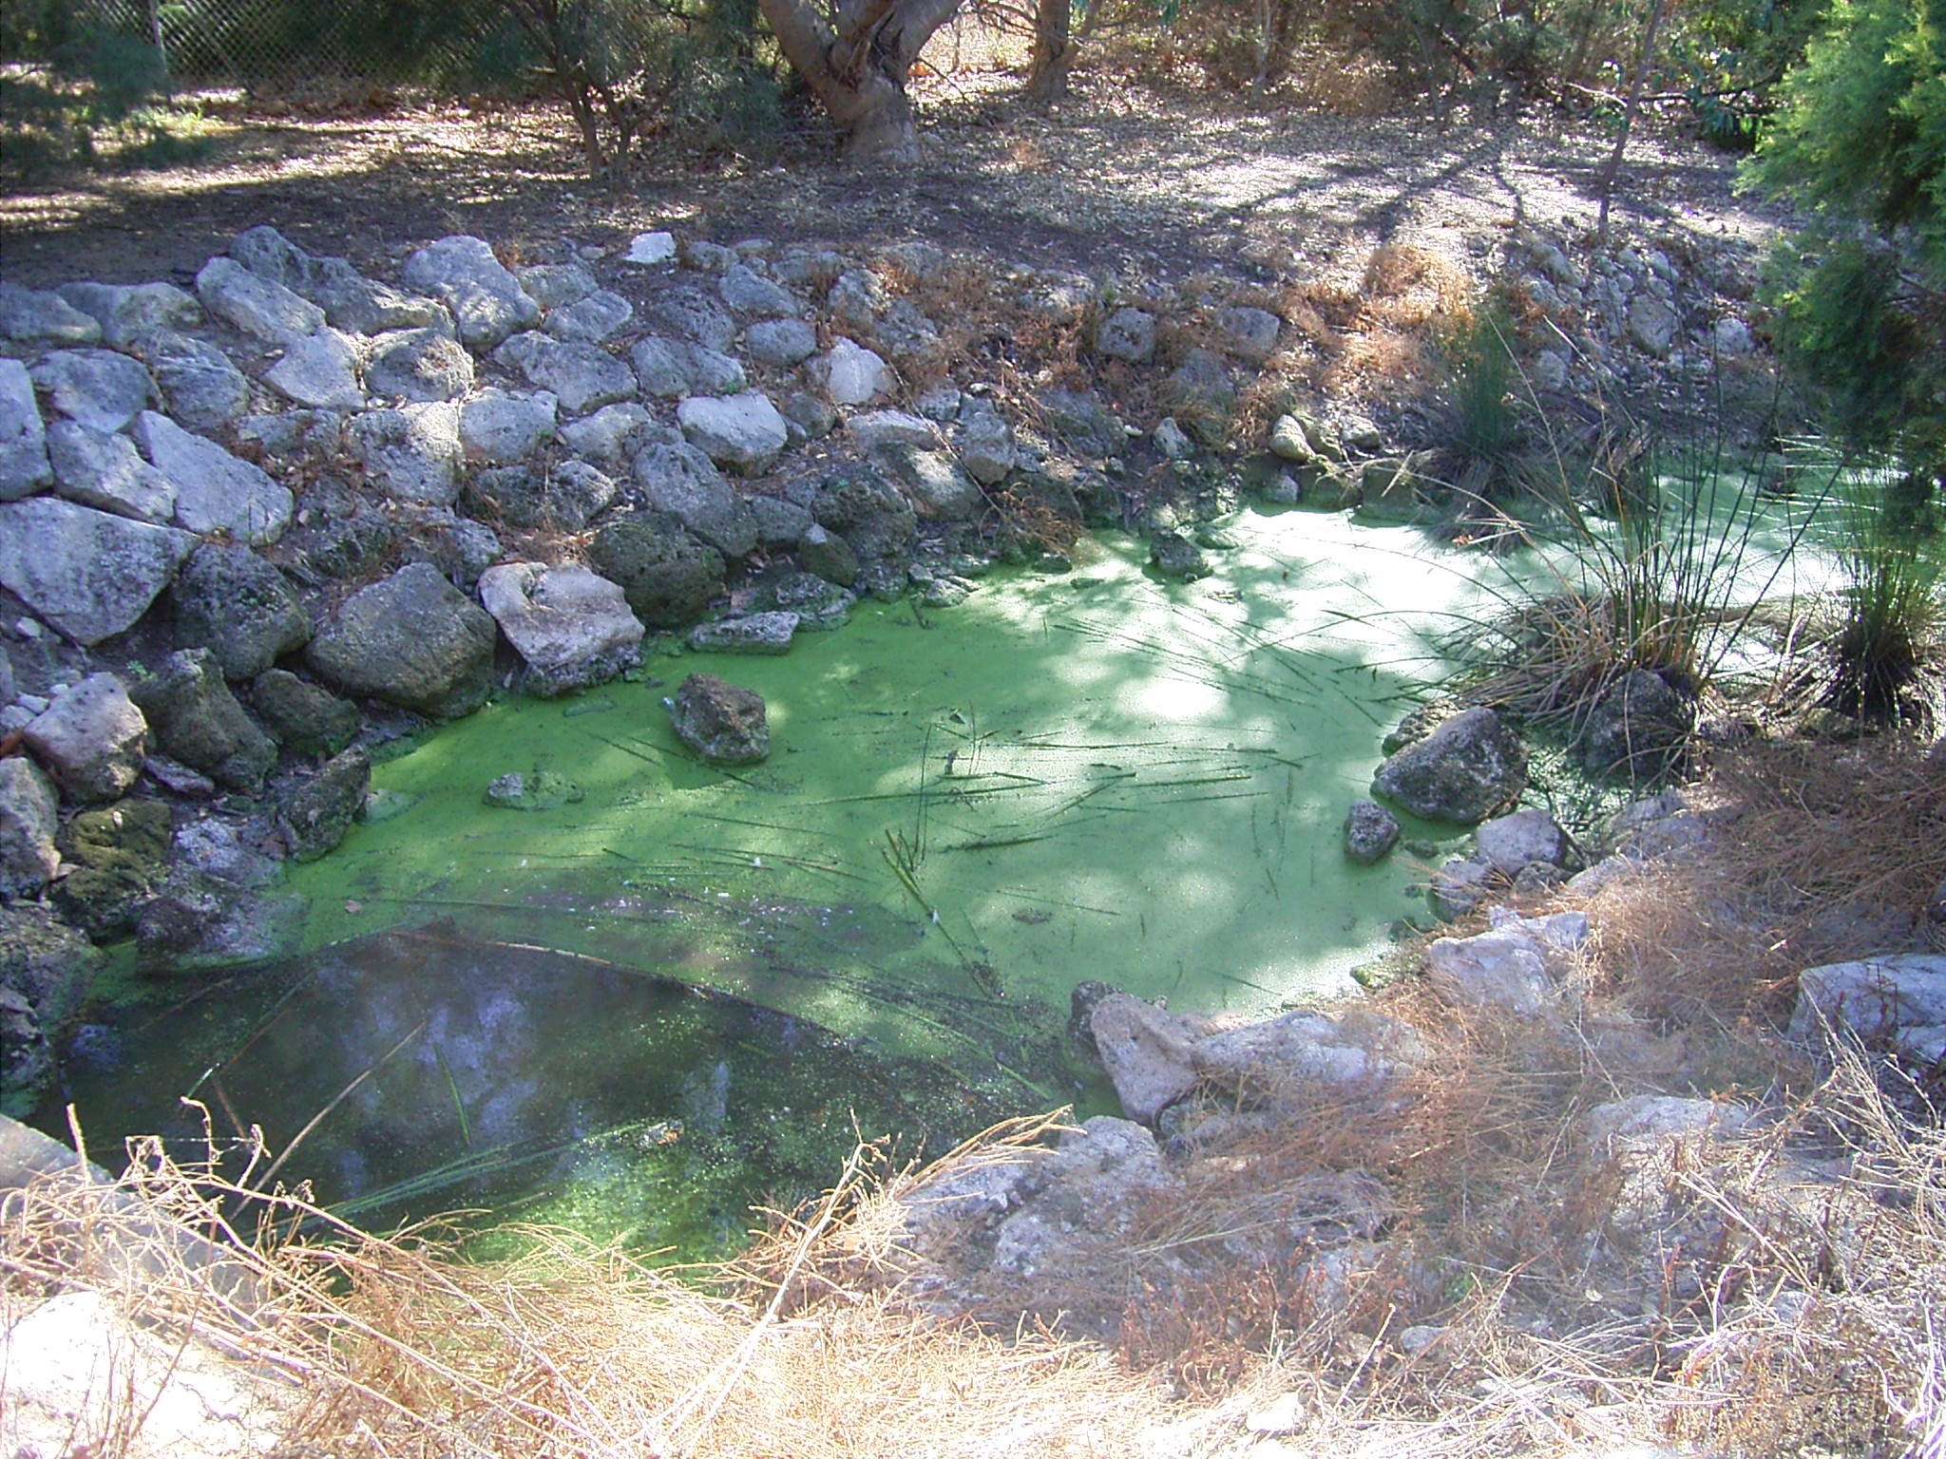
Notes:
Ask the students to comment on the state of the channel water at the first drain’s point of entry (north east corner of the lake). Ask them to give it a water quality rating out of 10 where 10/10 is the best and 1/10 is the worst. Ask the students to suggest the reasons why the water quality here may be relatively poor. Some notes on the next slide may be of assistance.

Slide 19
Comment on the state of the channel water
Based on your observations, give it a water quality rating out of 10 where 10/10 is excellent and 1/10 is poor
Suggest the possible sources of nutrients entering the channel
Impact 1: Eutrophication
Activity

Slide 20
Possible sources of nutrients
Run-off from fertilisers used by residents in surrounding suburbs such as Leederville and Wembley wash into the lake from the drains
Whatever goes into the drains along the sides of the road is likely to end up in the lake, so pollutants like oil from vehicles also wash into the lake from the adjacent Mitchell Freeway
Clearing of native vegetation from the lake has also led to nutrient enrichment in the waterway as they help to absorb nutrients entering the water body
What else came up in your discussion?
Impact 1: Eutrophication
Activity

Slide 21
Environmental impacts
If large areas of the lake become covered by algae, it prevents sunlight reaching the bottom of the lake. This prevents the process of photosynthesis from taking place. As a result, water grasses and plants decline in number. This is significant as these plants make up the base of local food chains
Also over time as the algae begins to decompose large amounts of oxygen are used from the water. This ‘robs’ fish and other species in the water from oxygen putting these species at risk
What further impacts could this have on local food chains and webs? Consider primary, secondary and tertiary consumers
Impact 1: Eutrophication
Activity

Slide 22
Social and economic impacts
Discuss the various impacts that eutrophication could have on society and the economy.
Impact 1: Eutrophication
Activity

Slide 23
Impact 2: Declining health of fauna
Activity
Study the signs shown on the following slide.
What possible impacts could occur to wildlife if visitors feed the birds?

Slide 24
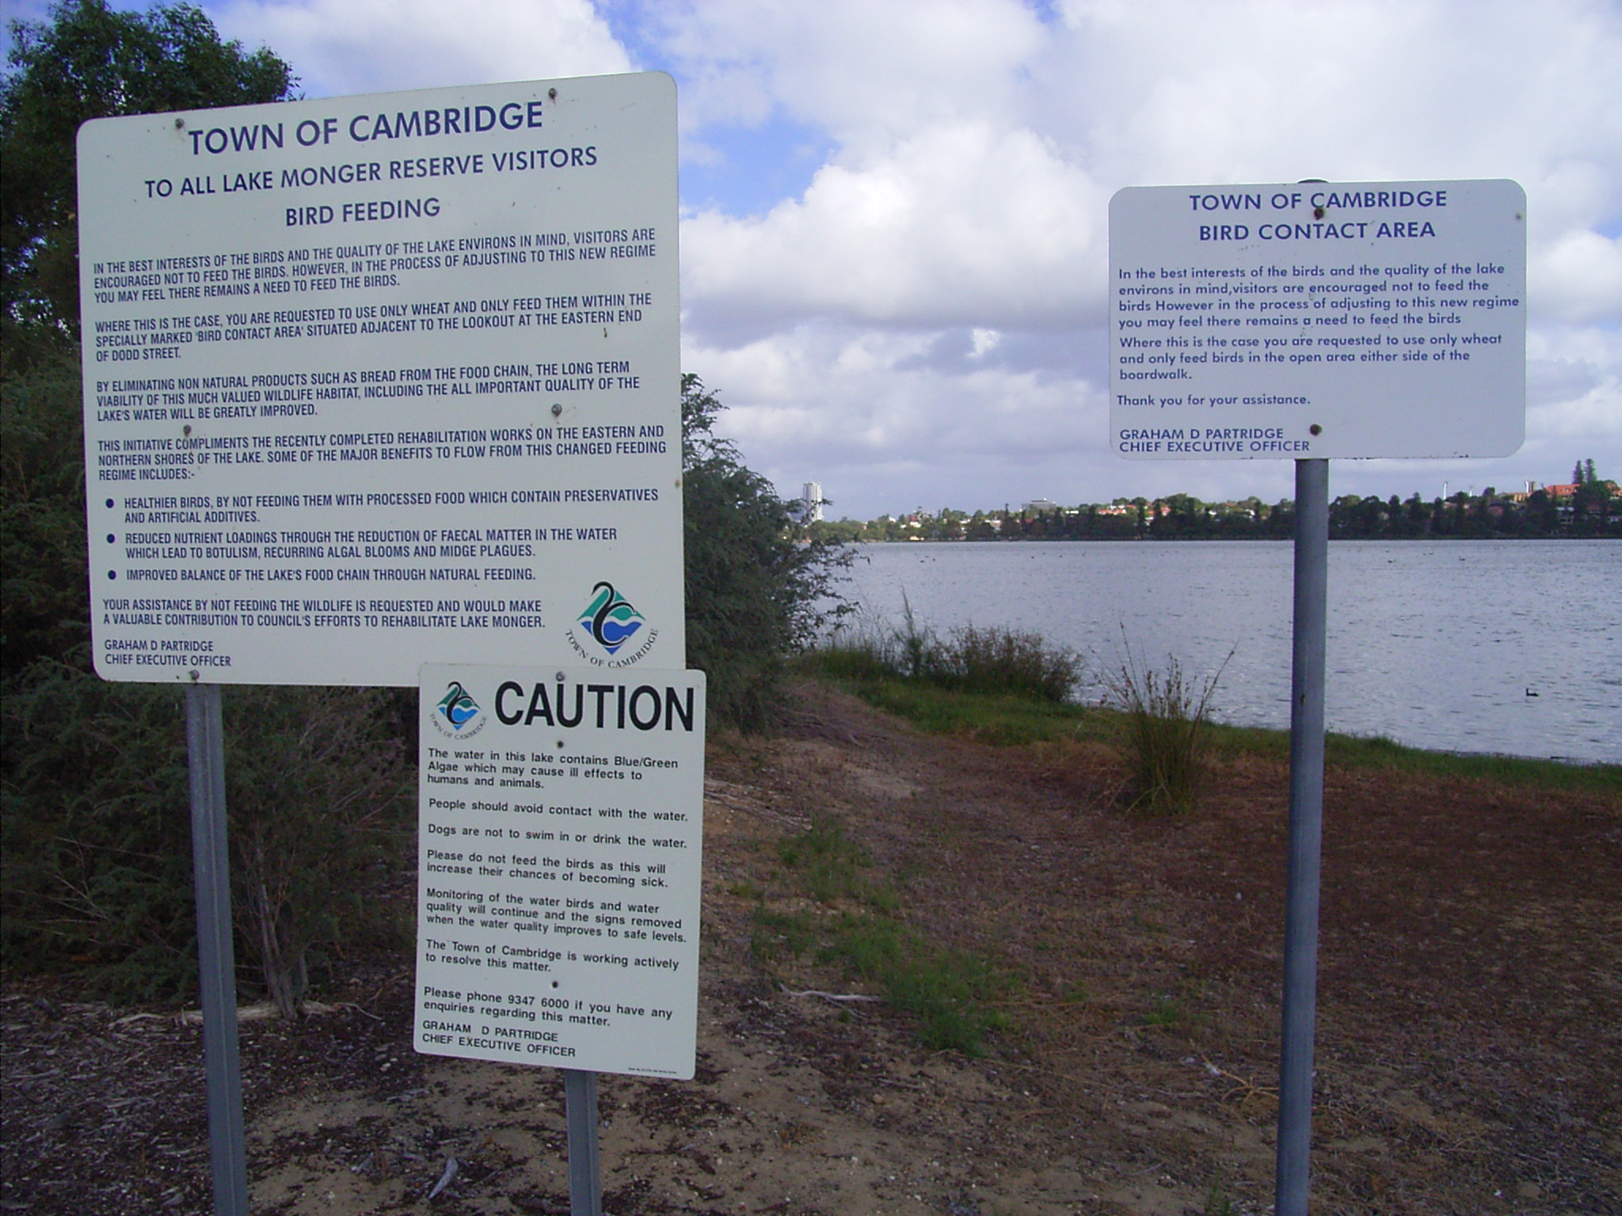

Slide 25
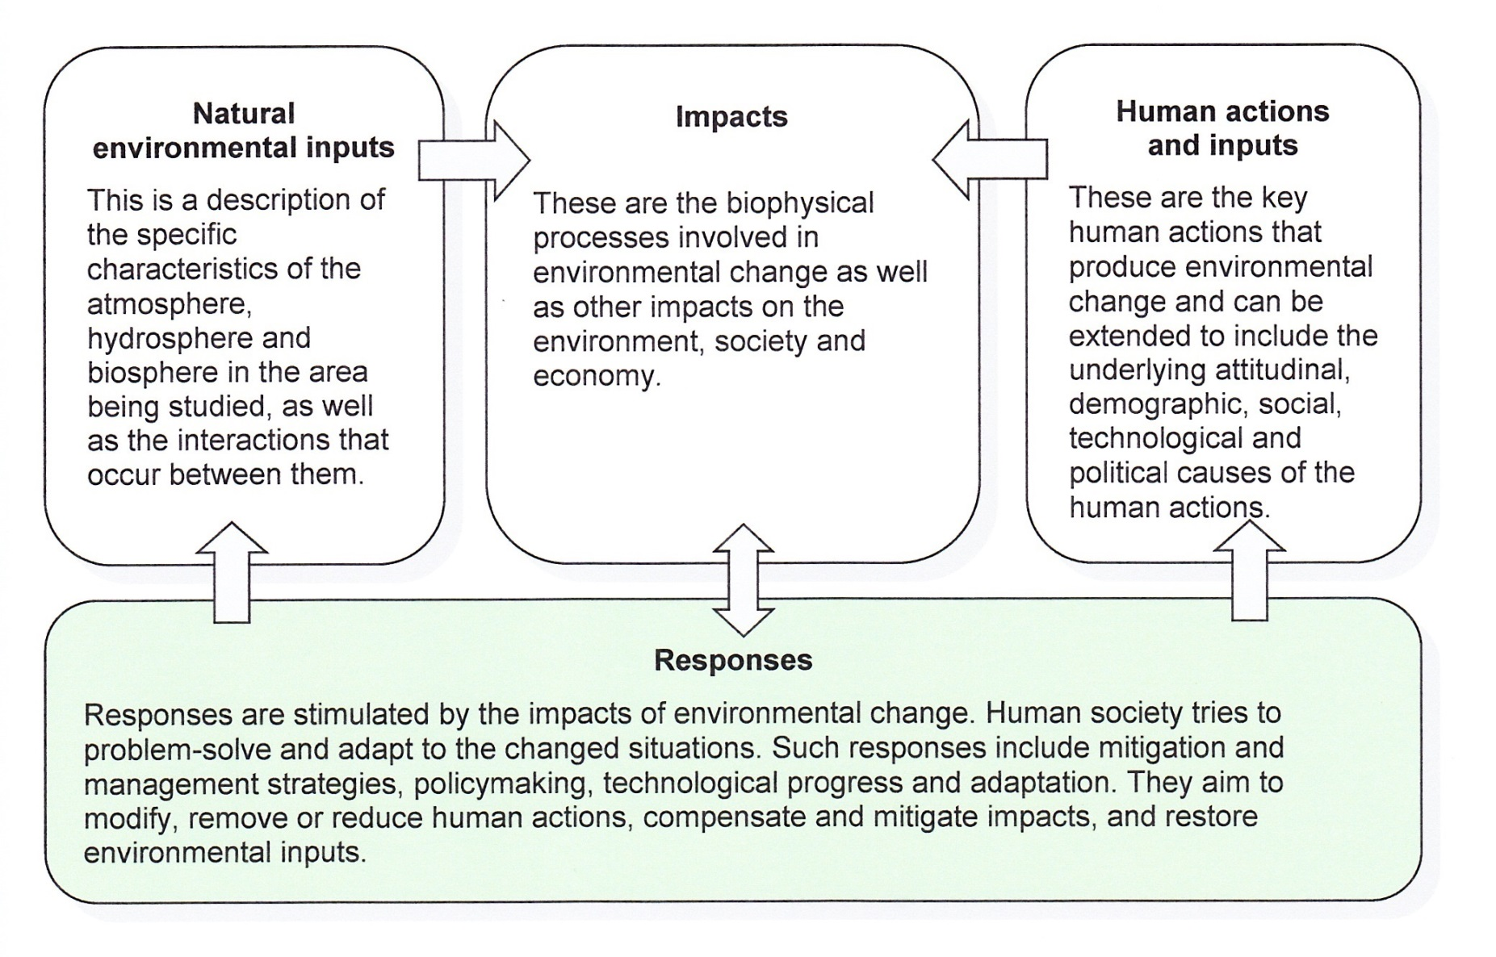
Responses

Slide 26
Modification of Lake Monger has been undertaken in order to manage the negative human impact on the ecosystem.
Notes:
Point out the reshaping of the lake’s shoreline to create a stripping channel.

Slide 27
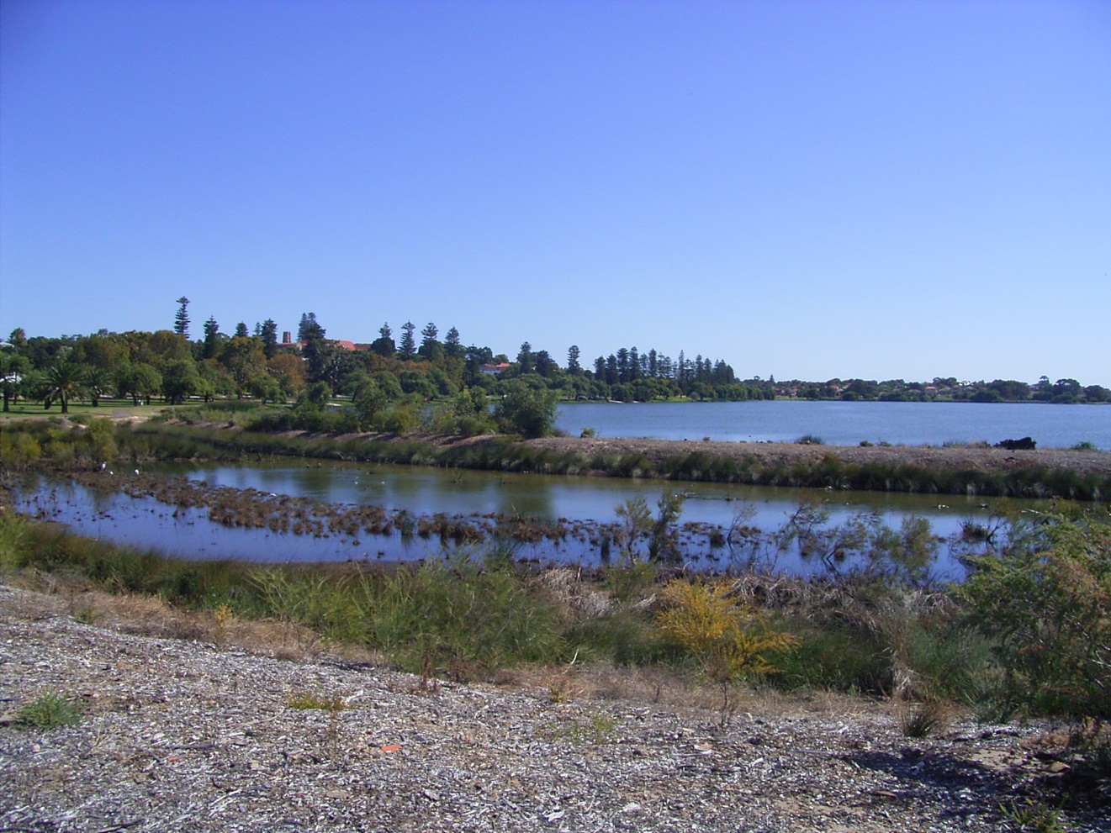
Managing human impacts
The shoreline on the eastern side of Lake Monger has been reshaped to incorporate a nutrient-stripping channel
Notes:
Get the students to continue to give ratings of the water quality as you walk along the lake. Pick three points to use. Generally speaking the students should see an improvement in the water quality as they move south along the lake so their ratings out of 10 should increase. This will help them to evaluate the effectiveness of the management strategies being used.

Slide 28
Managing human impacts
Plantings of local native vegetation have also taken place between the channel and the main lake to help absorb the nutrients before they reach the lake and feed the algal blooms
Species include Eucalyptus rudis and Melaleuca preisiana
They assist in reducing the levels of nitrogen and phosphorus in the water, thereby depriving algae of these nutrients for growth
Notes:
Get the students to continue to give ratings of the water quality as you walk along the lake. Pick three points to use. Generally speaking the students should see an improvement in the water quality as they move south along the lake so their ratings out of 10 should increase. This will help them to evaluate the effectiveness of the management strategies being used.

Slide 29
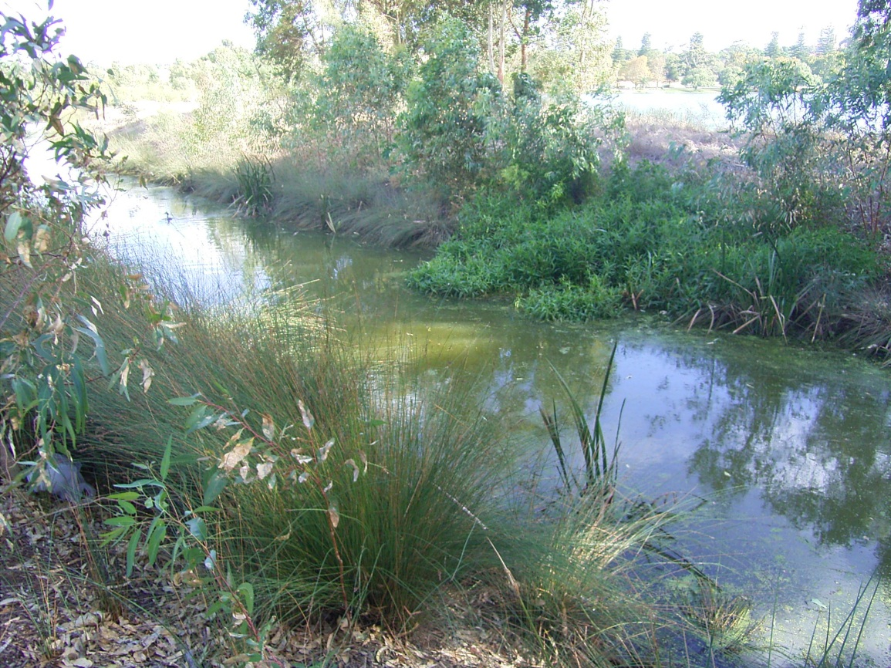
Notes:
Get the students to continue to give ratings of the water quality as you walk along the lake. Pick three points to use. Generally speaking the students should see an improvement in the water quality as they move south along the lake so their ratings out of 10 should increase. This will help them to evaluate the effectiveness of the management strategies being used.

Slide 30
Activity
Sketch the photo on the next slide and label the following:
Lake Monger
nutrient stripping channel
replanting of native vegetation
evidence of eutrophication
Notes:
Get the students to continue to give ratings of the water quality as you walk along the lake. Pick three points to use. Generally speaking the students should see an improvement in the water quality as they move south along the lake so their ratings out of 10 should increase. This will help them to evaluate the effectiveness of the management strategies being used.

Slide 31
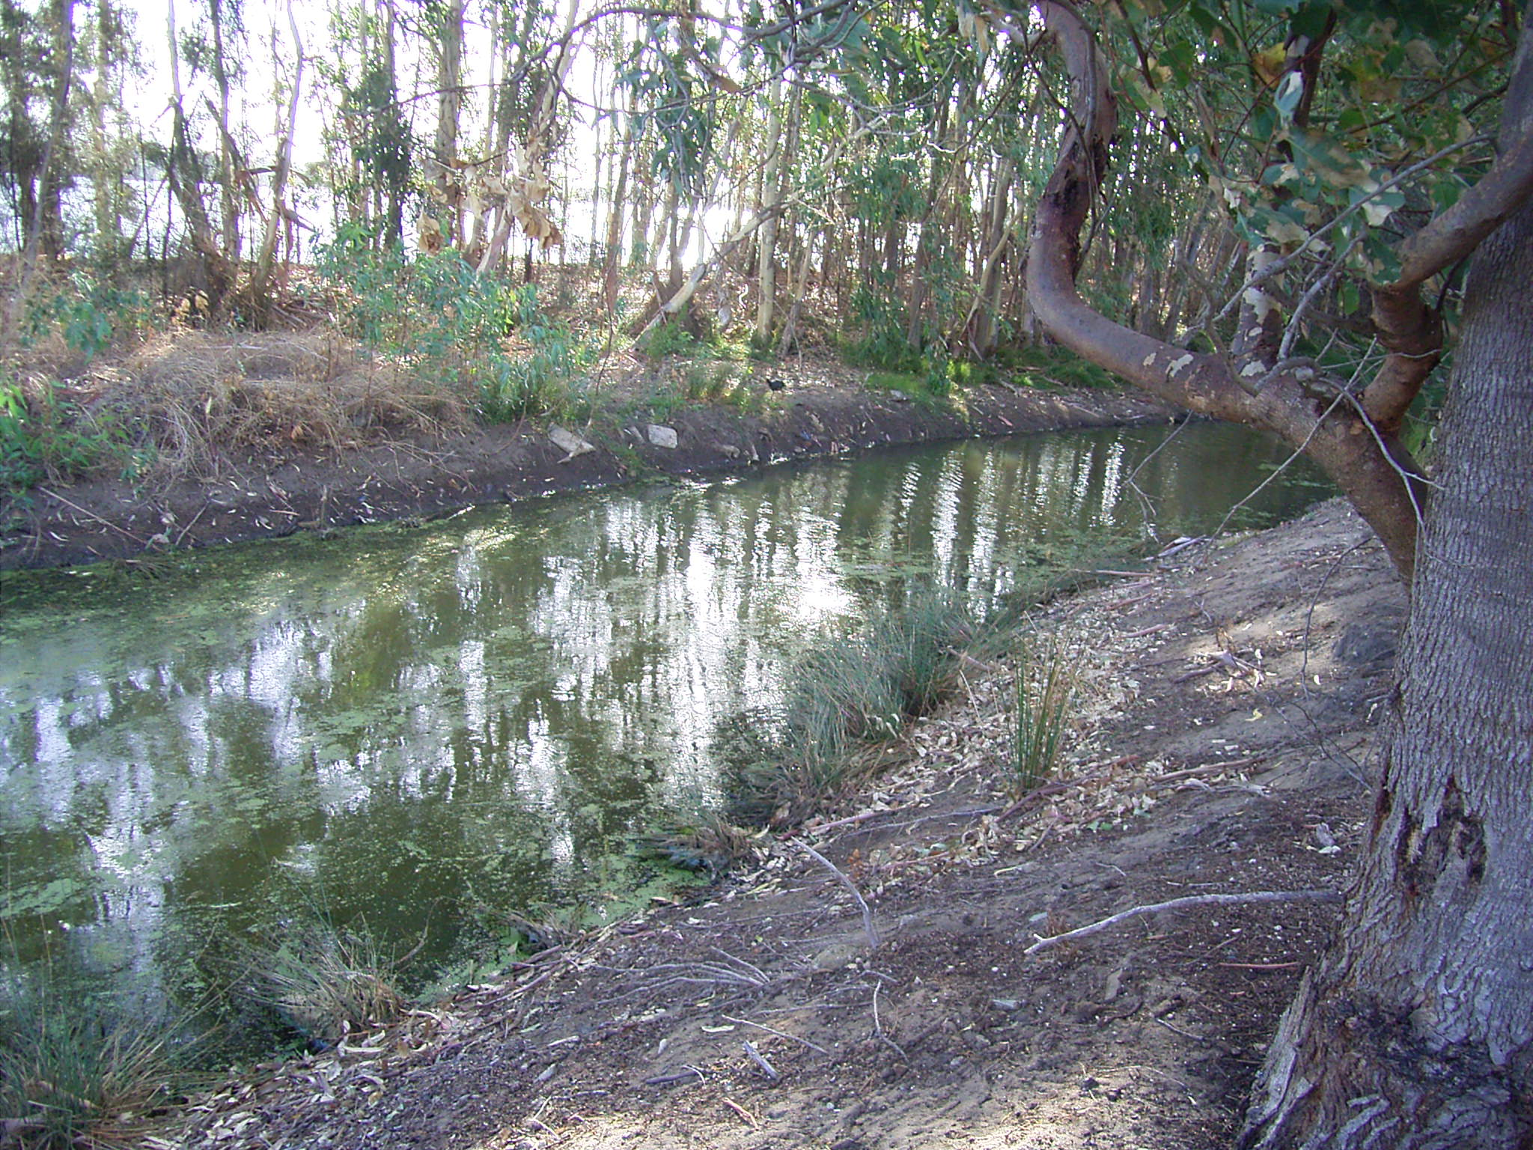
Notes:
Planting of native species, including Eucalyptus rudis and Melaleuca preisiana, absorb many of the nutrients before they reach the lake. This assists in reducing the levels of nitrogen and phosphorus in the water, thereby depriving algae of these source of nutrients for growth. Note the purpose of the grid over this photo was so that the students could draw a photo sketch and annotate our points of discussion. Worthwhile doing in class with the students when you return. It will mean you get better quality written answers.

Slide 32
Other benefits of native plantings
The shade of local native plants also helps to cool the water and provide a habitat for invertebrates that eat midge larvae
Waterbirds and other wetland creatures now have a greater diversity of habitats for living at Lake Monger

Slide 33
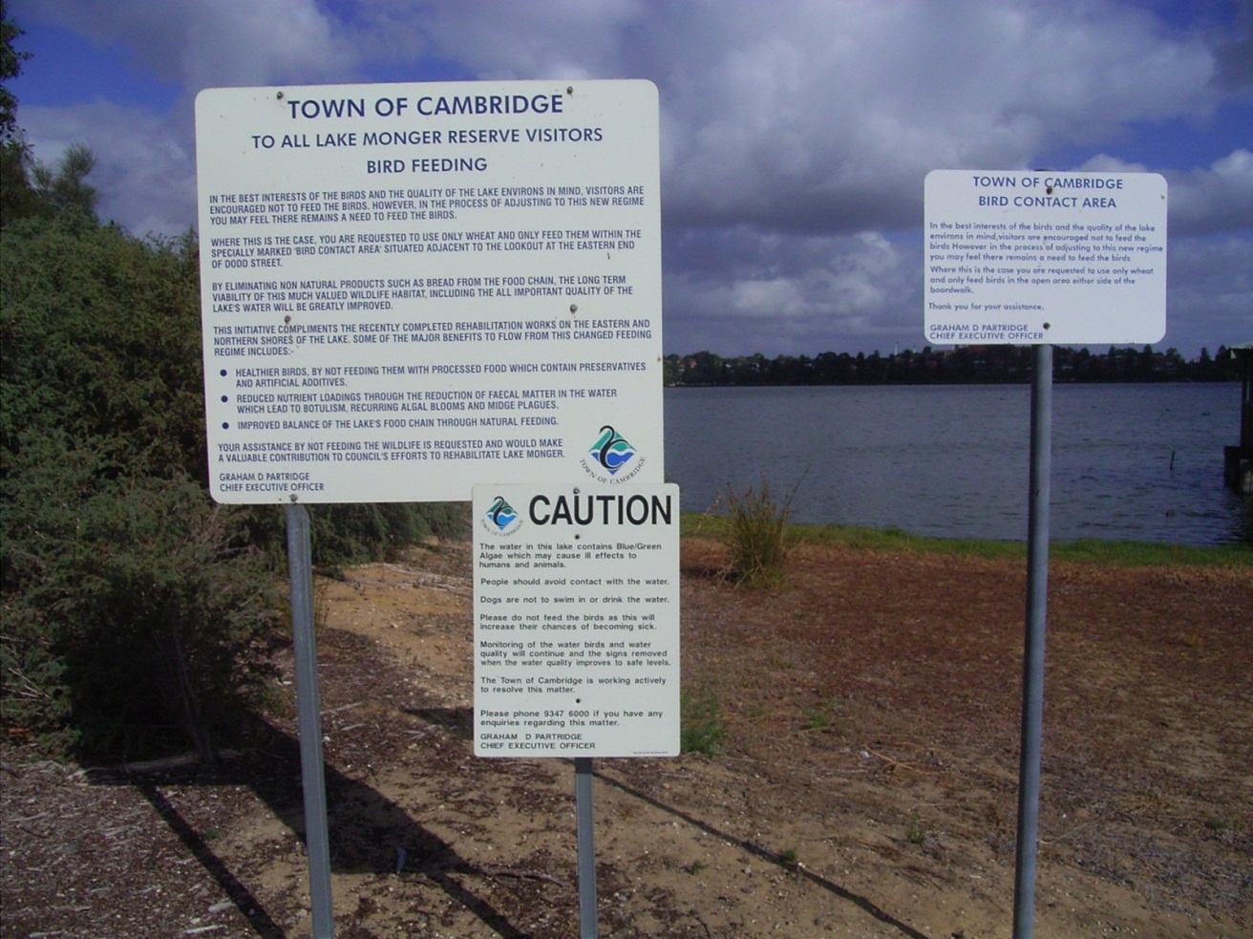
Activity
Study these signs again. How is eutrophication reduced by not feeding the birds?

Slide 34
Other ongoing responses
It has been recommended that environmental improvements be made such as stormwater monitoring, planting of more fringing vegetation, eliminating the use of fertilisers, and educating people
Research is continuing into possible solutions in an attempt to address the eutrophication problem.
Notes:
Get the students to continue to give ratings of the water quality as you walk along the lake. Pick three points to use. Generally speaking the students should see an improvement in the water quality as they move south along the lake so their ratings out of 10 should increase. This will help them to evaluate the effectiveness of the management strategies being used.

Slide 35
Evaluation
How do we know the management strategies implemented by the Town of Cambridge and the Water Corporation are working?
Notes:
Get the students to continue to give ratings of the water quality as you walk along the lake. Pick three points to use. Generally speaking the students should see an improvement in the water quality as they move south along the lake so their ratings out of 10 should increase. This will help them to evaluate the effectiveness of the management strategies being used.

Slide 36
Evaluation method
In this virtual tour, a simple evaluation method was used to provide valuable information on the effectiveness of current management strategies
Students gave a rating of 1–10 at three different points along the channel and then at the main lake
10/10 was excellent and 1/10 was poor
Notes:
Get the students to continue to give ratings of the water quality as you walk along the lake. Pick three points to use. Generally speaking the students should see an improvement in the water quality as they move south along the lake so their ratings out of 10 should increase. This will help them to evaluate the effectiveness of the management strategies being used.

Slide 37
Do you remember this part of the channel at the entry point of the first drain located in the north-eastern corner of the lake?
What rating did you give it out of 10? Why?

Slide 38
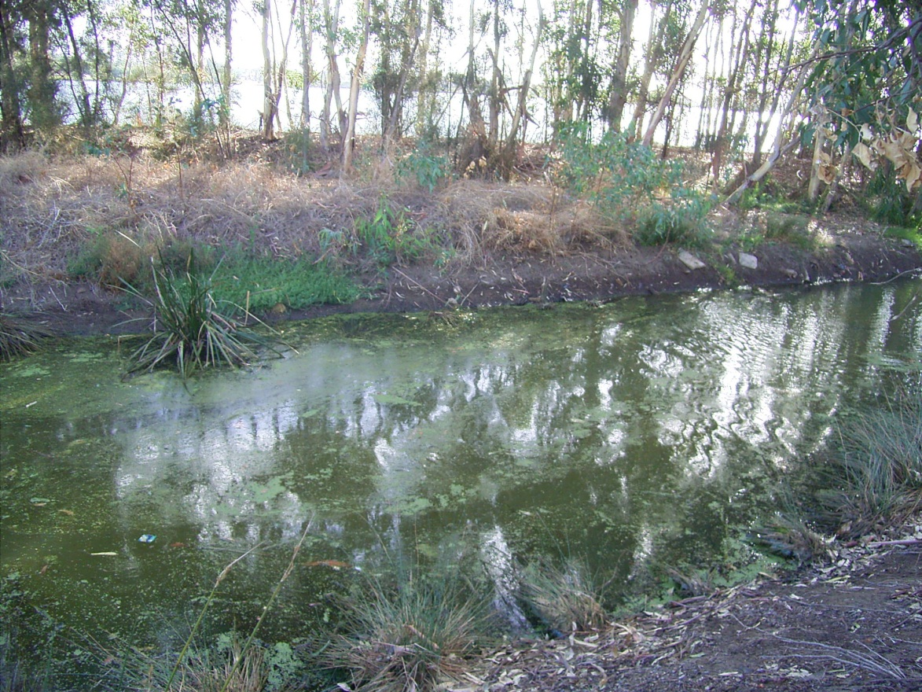
As you travel further south along the channel this is what you see
Give it a rating out of 10. Justify your rating

Slide 39
Again as you travel further south along the channel this is what you see
Give it a rating out of 10 and justify your rating

Slide 40
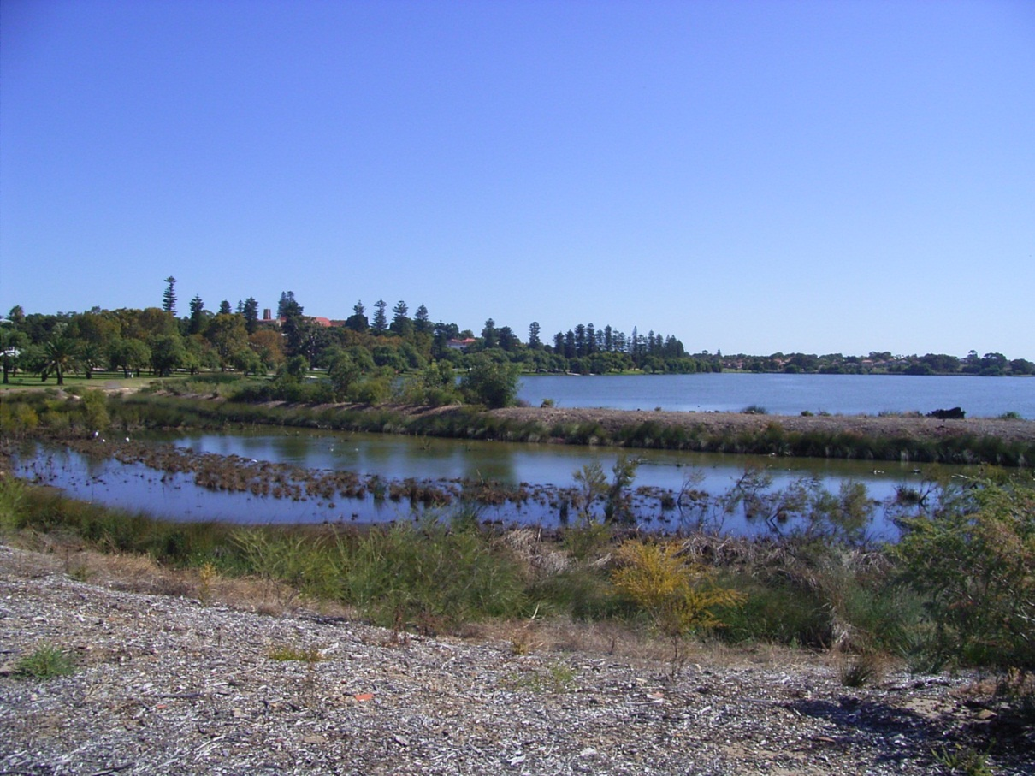
This is the southern most end of the channel. You can also see the main lake from here
Give it a rating out of 10 and justify your rating

Slide 41
Water quality testing using the pH kit
pH measures the acidity or alkalinity of the water in the lake
A pH of 7 is considered neutral
The pH of the water is important to aquatic life
If the pH falls below 4 or rises above 9 then life will struggle to survive

Slide 42
Activity
Fill a test tube with lake water (away from the drains). Use a few drops of universal indicator to determine the pH of the lake
Repeat this testing at various places along the nutrient stripping channel and in the main lake

Slide 43
Water quality testing using aquatic invertebrates
While tests for pH can reveal a lot about the health of a wetland, another way to determine the water quality is to find, examine, and count aquatic invertebrates
Aquatic invertebrates are very good indicators of whether the water is clean or polluted. This is because many invertebrates are highly sensitive to pollution

Slide 44
Activity
Carefully take a scoop of sediment from the lake
Use the identification and rating charts which have been provided. Follow the instructions on them to help you determine the water quality
Determining the water quality
The presence of highly sensitive organisms that can only survive in clean water is a good indicator that all is well in the wetland. For example, a lake that contains caddis flies and mayflies is a healthy pond
A pond that only contains worms, flatworms, and snails is likely to be unhealthy

Slide 45
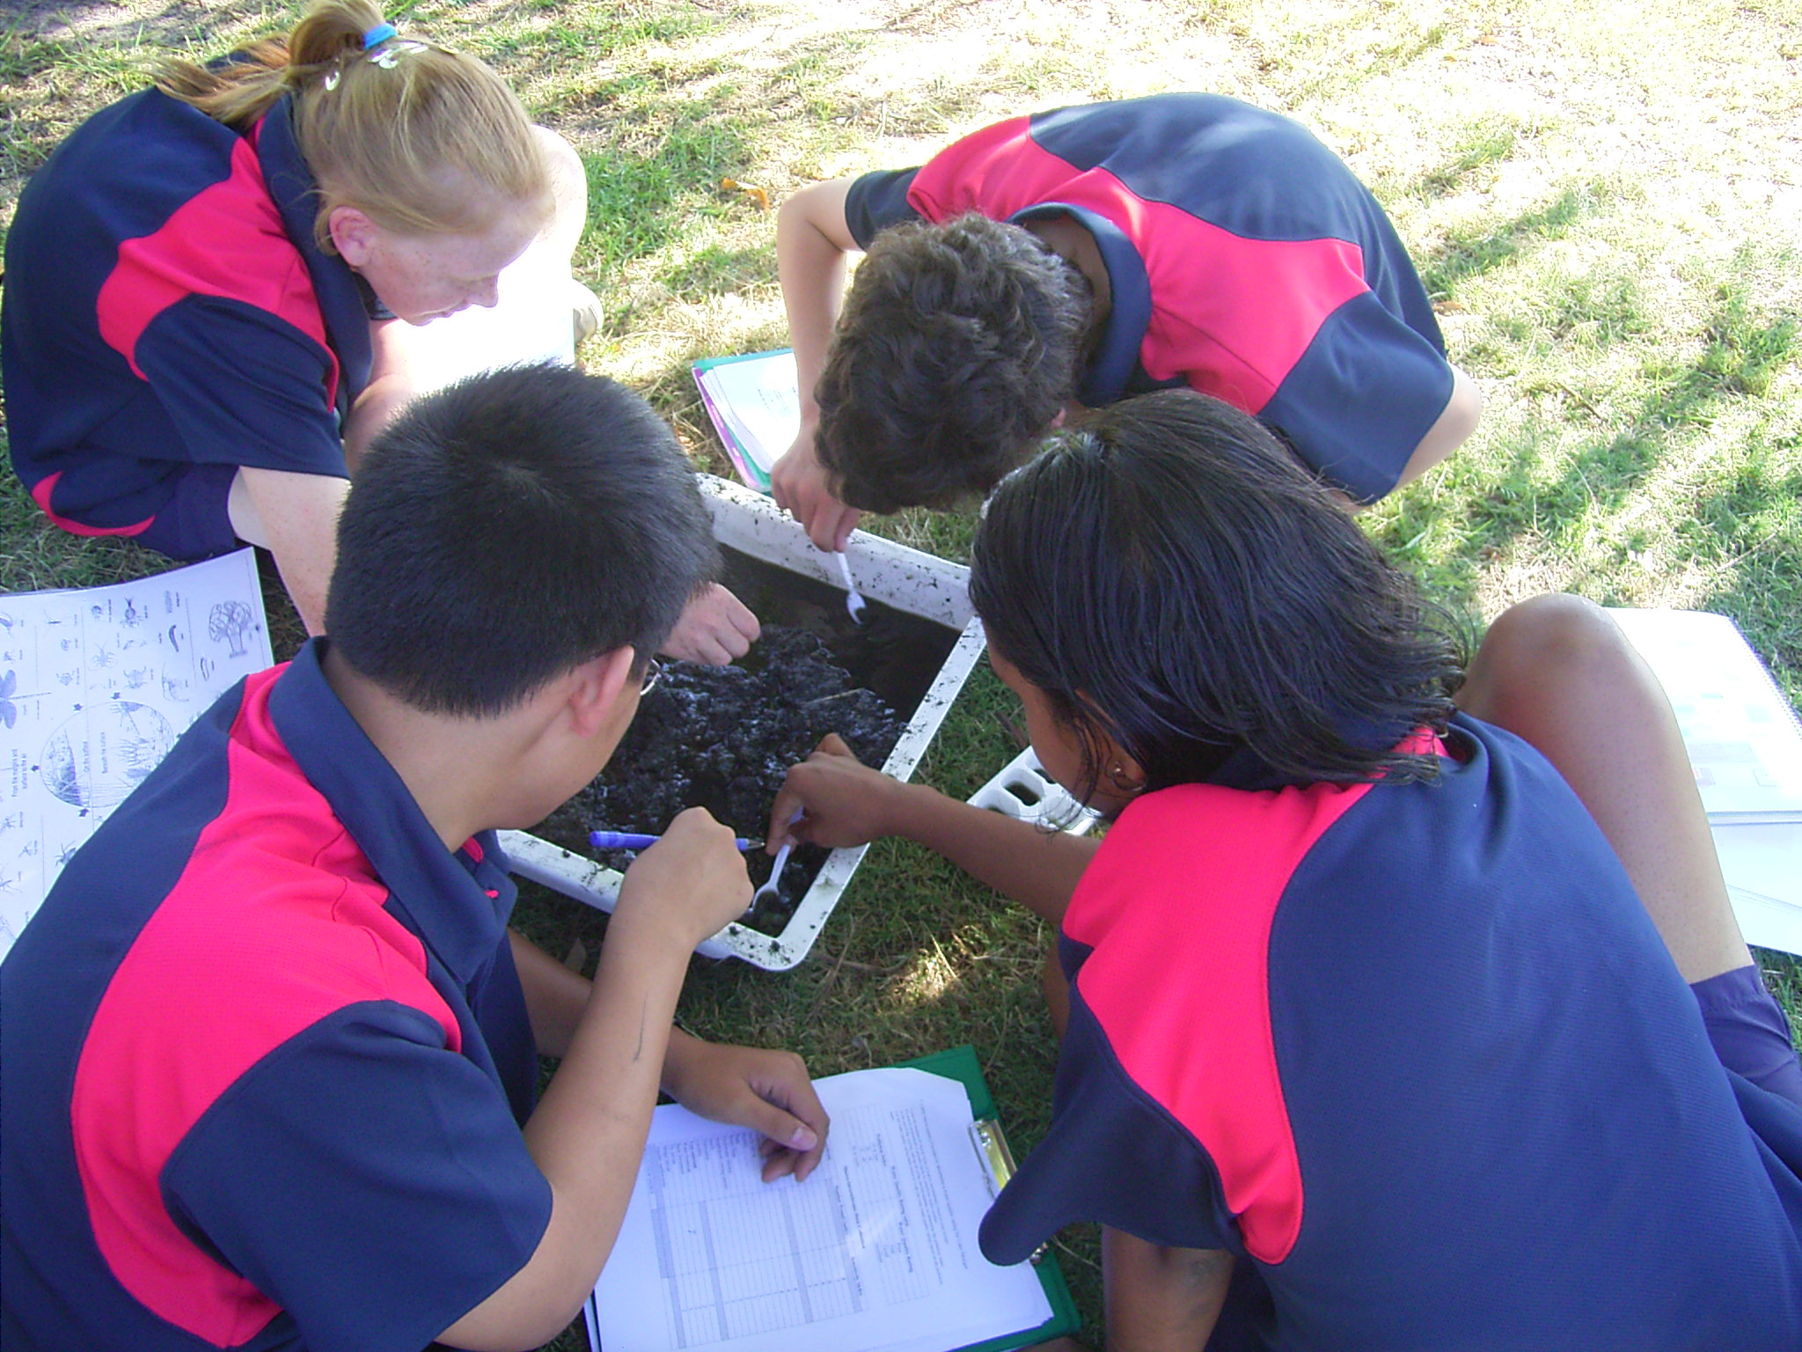

Slide 46
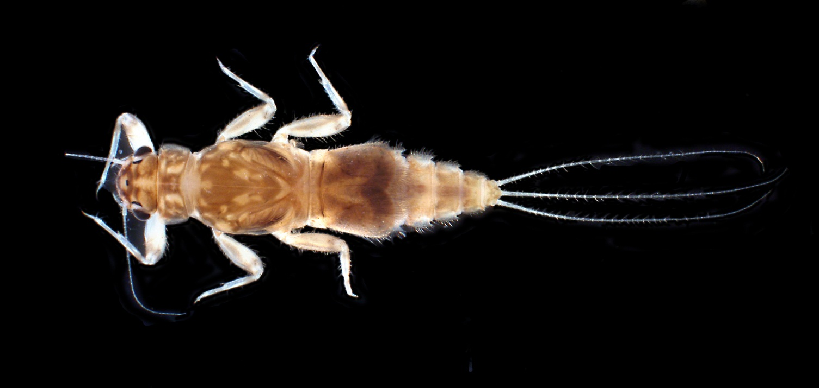
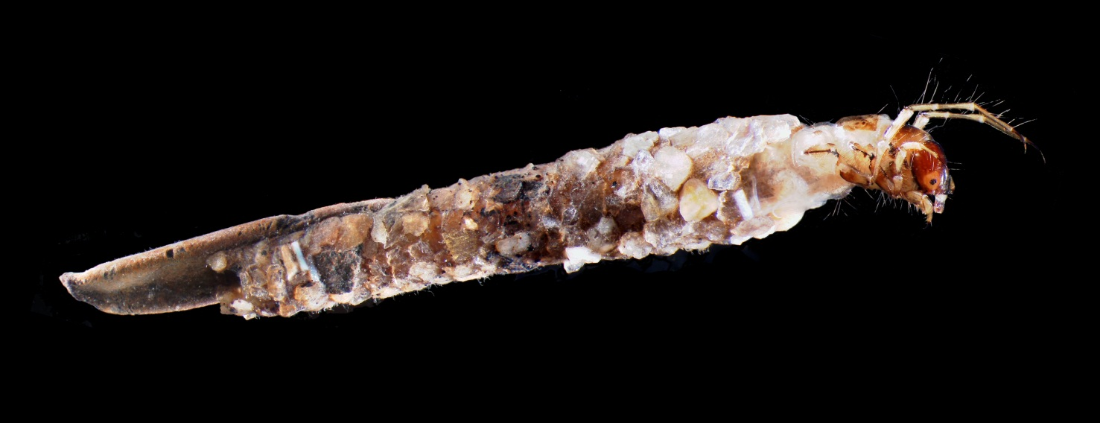
Mayfly
Caddis fly
© Department of Environment and Conservation, Western Australia

Slide 47
Activities
Try the following activities based on the virtual fieldwork you have completed
Describe the various source, sink, service and spiritual functions of Lake Monger
Construct a human-environment system diagram on a large sheet of paper and insert a summary of the elements for Lake Monger
Describe one major environmental impact which has occurred as a result of human actions and specify the biological processes involved
Outline one strategy which has been used to overcome this impact and evaluate its effectiveness
Notes:
Do the scoops with the students. They need to identify the count of invertebrates that are pollution sensitive and pollution resistant. The guide for this should be in the fieldwork booklet which students have. Try and scoop away from the drains and as far away from the shoreline as possible.

Slide 48
Visit a local wetland and complete your own fieldwork!
Source: All images created and supplied by Tamara Boyer unless specified otherwise
Notes:
Do the scoops with the students. They need to identify the count of invertebrates that are pollution sensitive and pollution resistant. The guide for this should be in the fieldwork booklet which students have. Try and scoop away from the drains and as far away from the shoreline as possible.

